Slide 1

Blended Diffusion for Text-driven Editing of Natural Images
CVPR, 2022
310552069 王盈皓
311553009 許瑋芸
311552004 李明倫

Slide 2
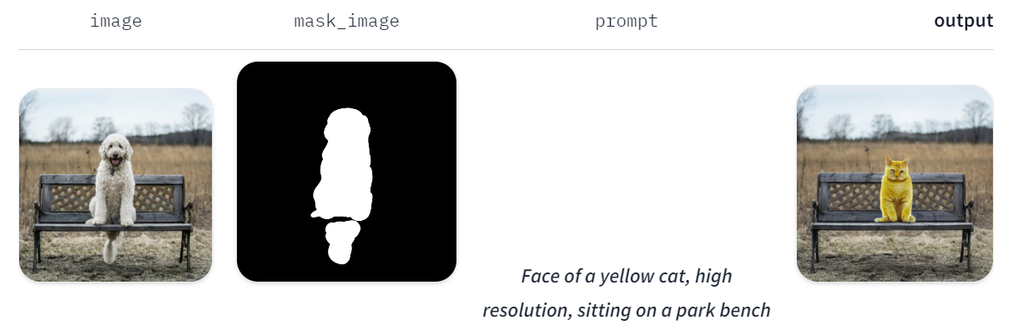


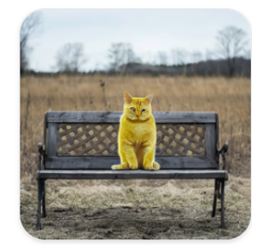

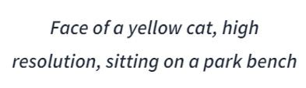
Introduction
Region-based editing of real-world natural images using natural language text guidance.

Slide 3
Goal
Can operate on real images, rather than generated ones
Not restricted to a specific domain, such as human faces or bedrooms
Modifies only a user-specified region, while preserving the rest of the image.
Yields globally coherent (seamless) editing results.
Capable of generating multiple results for the same input.

Slide 4
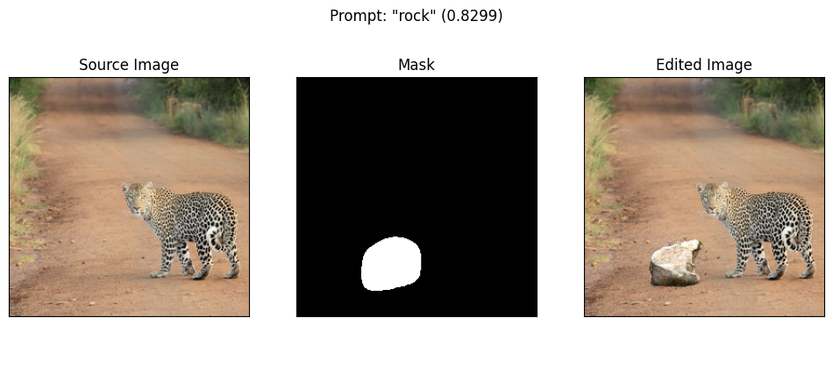
Goal

Slide 5
Goal
The transition should be seamless.

Slide 6
Goal
The masked region should be consistent with text prompt

Slide 7
Goal
The unmasked region should be consistent with source image

Slide 8
Method

Slide 9
Related work
DDPM
CLIP
Paint by word
not able to edit real world images, and no strictly background preservation
Paint by word++ (VQGAN-CLIP + Paint by word)
can applied on real world images
Bau, D., Andonian, A., Cui, A., Park, Y., Jahanian, A., Oliva, A., & Torralba, A. (2021). Paint by word. arXiv preprint arXiv:2103.10951

Slide 10
Local CLIP-guided diffusion
Dhariwal and Nichol use a classifier pretrained on noisy images to guide generation towards a target class
A pretrained CLIP model may be used to guide diffusion towards a target prompt
Prafulla Dhariwal and Alexander Nichol. Diffusion models beat gans on image synthesis. Advances in Neural Information Processing Systems, 34, 2021.

Slide 11
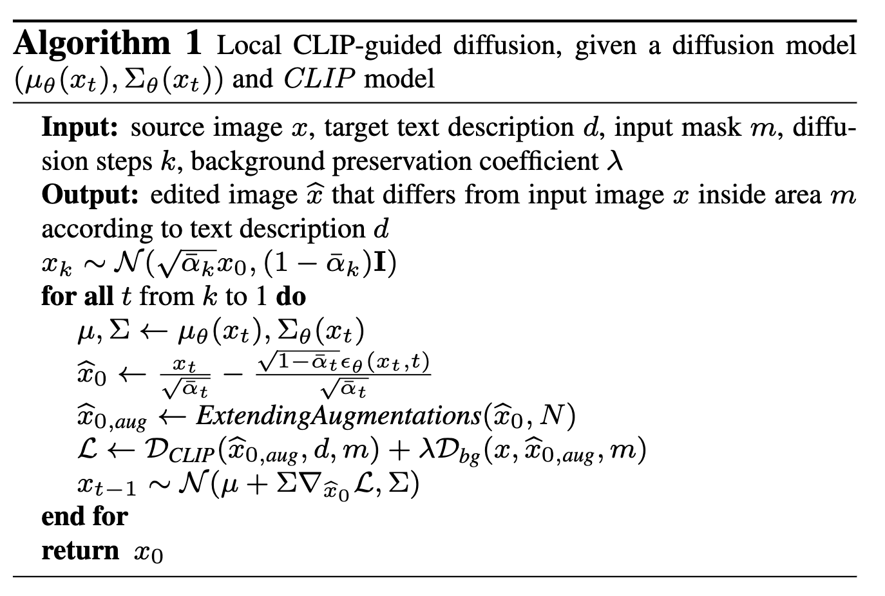
Local CLIP-guided diffusion

Slide 12
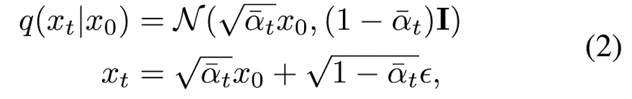
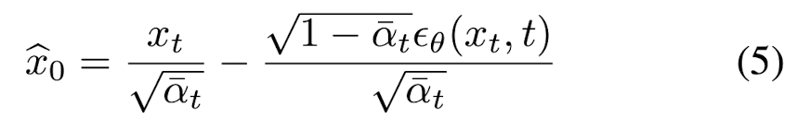
Local CLIP-guided diffusion

Slide 13
Local CLIP-guided diffusion

Slide 14
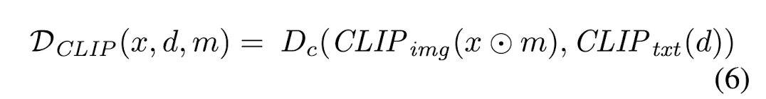
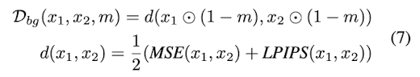
Local CLIP-guided diffusion

Slide 15
Local CLIP-guided diffusion

Slide 16
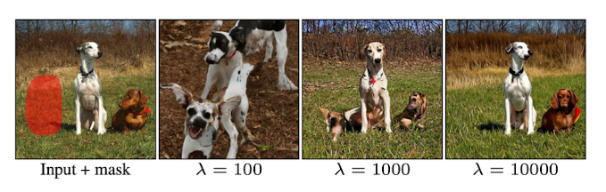
Local CLIP-guided diffusion
Problem: Even with a relatively large lambda=1000, the background is only roughly preserved and the foreground is severely limited

Slide 17
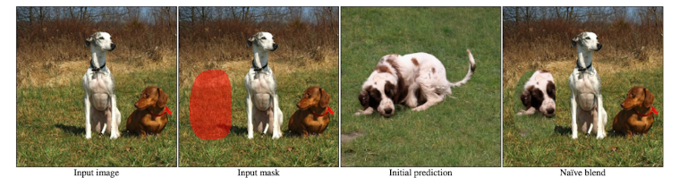
Background preserving blending
A Naïve way to preserve the background: Let lambda in algorithm 1 be 0 to get an image x_hat. Then replace the background with original image
Will fail to produce a seamless result

Slide 18
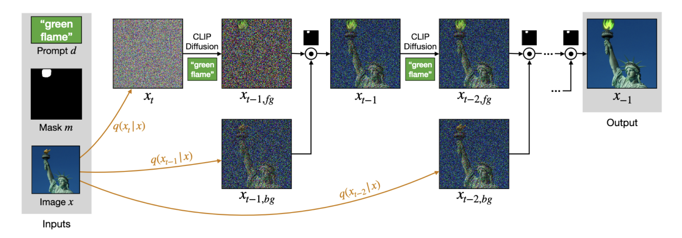
Text-driven blended diffusion
Blend each of the noisy images progressively generated by the CLIP-guided process with the corresponding noisy version of the input image

Slide 19
Background preserving blending
In their pioneering work, Burt and Adelson [7] show that two images can be blended smoothly by separately blending each level of their Laplacian pyramids
Our key hypothesis is that at each step during the diffusion process, a noisy la- tent is projected onto a manifold of natural images noised to a certain level. While blending two noisy images (from the same level) yields a result that likely lies outside the mani- fold, the next diffusion step projects the result onto the next level manifold, thus ameliorating the incoherence

Slide 20
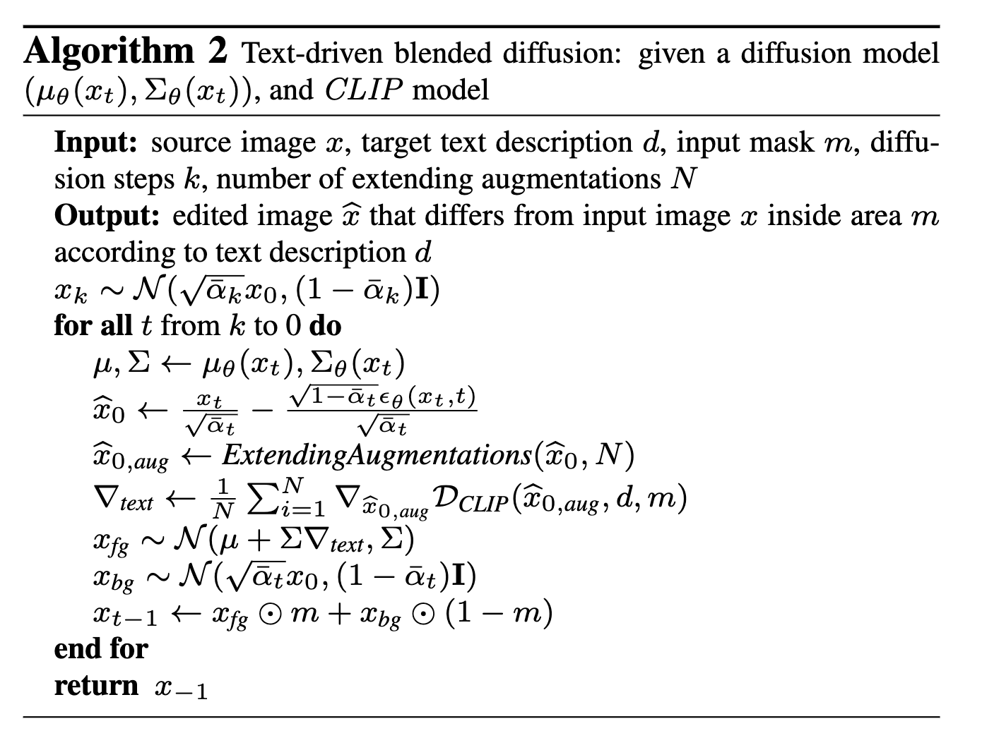
Text-driven blended diffusion

Slide 21
Text-driven blended diffusion
One step of local CLIP-guided diffusion with lambda = 0

Slide 22
Text-driven blended diffusion

Slide 23
Text-driven blended diffusion
t-1
CLIP-guided
denoising
t-2

Slide 24

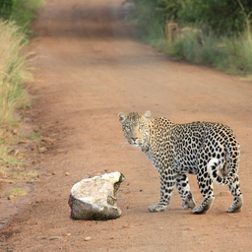
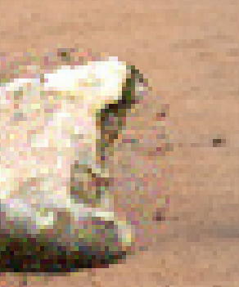
Text-driven blended diffusion
In the final step, the entire region outside the mask is replaced with the corresponding region from the input image

Slide 25
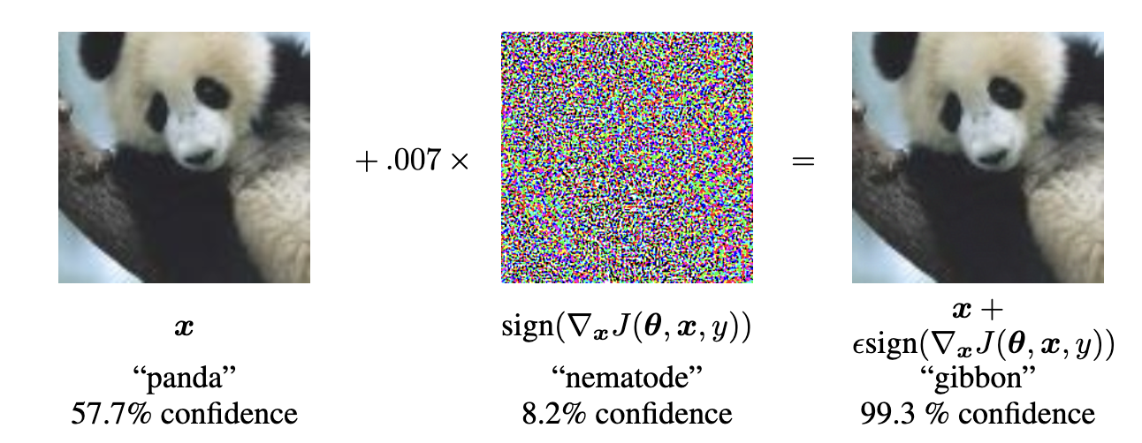
Extending augmentations
Adversarial examples is a well known phenomenon that may occur when optimizing an image directly on its pixel values
Goodfellow, I. J., Shlens, J., & Szegedy, C. (2014). Explaining and harnessing adversarial examples. arXiv preprint arXiv:1412.6572.

Slide 26
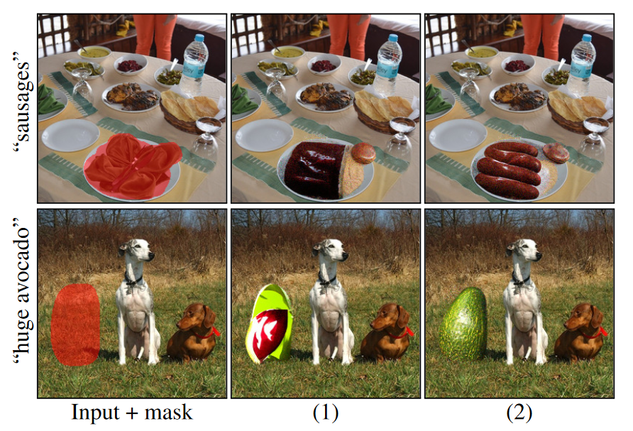


Extending augmentations
Random Perspective
Random Affine

Slide 27
Experiments

Slide 28
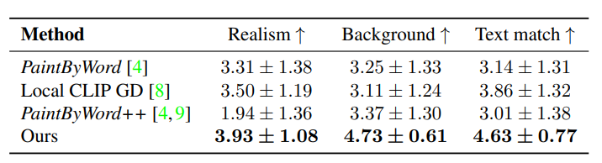
Quantitative comparison
They conducted a preliminary user study comparing between the different results of the baselines.

Slide 29
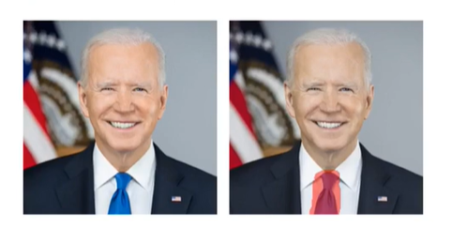
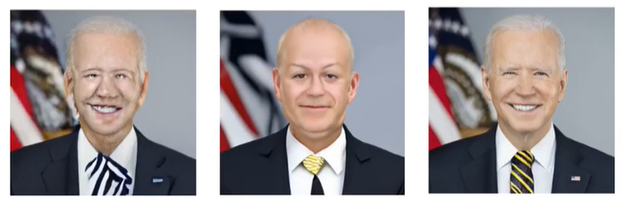
Qualitative comparison
+
“tie with black and yellow stripes”
Local CLIP-guided diffusion
VQGAN-CLIP
Our

Slide 30
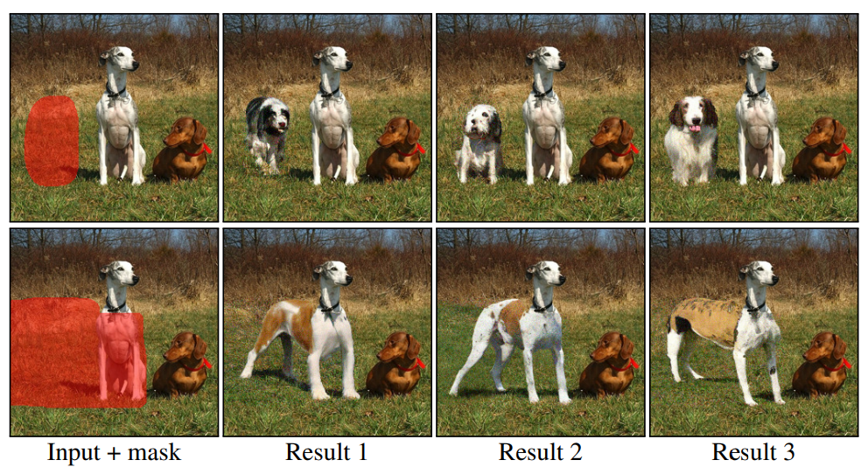
Text-driven object editing
“a dog”
“body of a standing dog”

Slide 31
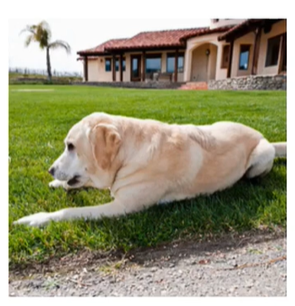
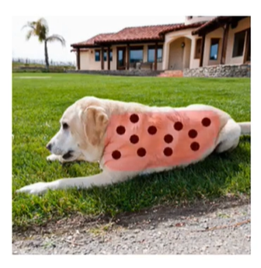
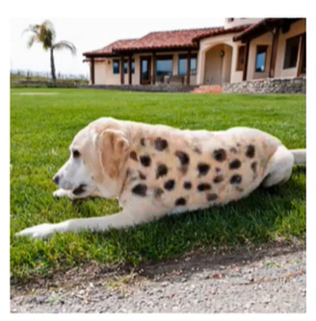
Scribble-guided editing
add scribble on existing object
add a mask around the scribble
condition on text prompt “leopard”

Slide 32
Conclusion

Slide 33
Conclusion
The proposed method improves the ability of the background preservation and outperforms the baselines.
Their method can achieve the multiple outcomes using the same text prompt.

Slide 34
Final Project Proposal

Slide 35
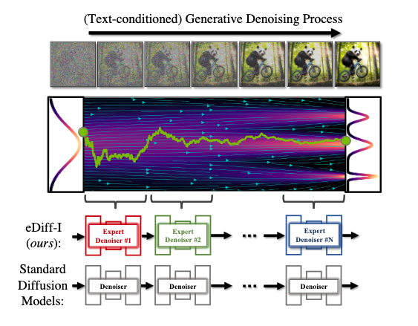
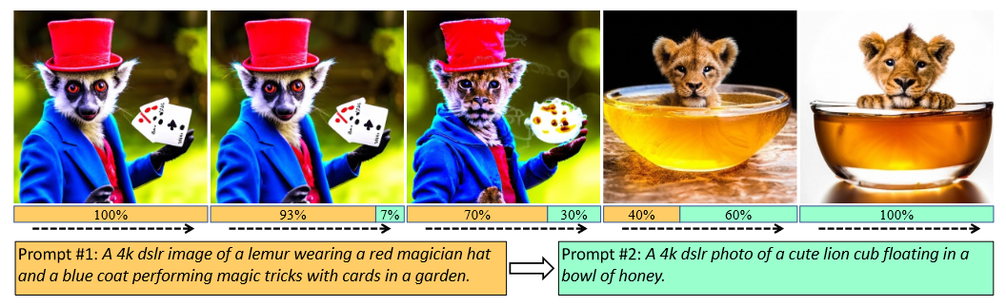
Proposal
Idea from eDiff-I
In text-to-image generation process, the denoiser focus on different aspects of the data during the different noise level
So they use an ensemble approach that different ‘expert denoisers’ are dedicated on different intervals of noise level
Balaji, Y., Nah, S., Huang, X., Vahdat, A., Song, J., Kreis, K., ... & Liu, M. Y. (2022). ediffi: Text-to-image diffusion models with an ensemble of expert denoisers. arXiv preprint arXiv:2211.01324.

Slide 36
Method
Instead of using different models in different steps, we will try to use 2 models in the same time to denoise with different scheduled weight coefficients
Task: Text-to-image / Class-conditional image generation
Datasets: MS COCO / ImageNet, …
Eval metrics: FID score, CLIP score / ResNet ImageNet-pretrained classifier, …
t=T……t=0
Expert 1
Denoise ratio
Expert 2

Slide 37
Method
Approaches:
Follow the paper proposed approach:
Pretrain one model for the whole process, then branch it into two separated experts for different noise levels
t=T……t=0
Pretrained model for all noise levels
Expert model 1 for higher noise levels
Expert model 2 for lower noise levels

Slide 38
Method
Approaches:
Our approach: Use the pretrained model from approach 1, then branch into two models which would denoise jointly with:
Linear weighted
Cosine weighted
(Learned weighted)
Model size:
Two models, each with the same size as the baseline
Reduce the total model’s size to match the size of the baseline

Slide 39
Thanks

